Slide 1


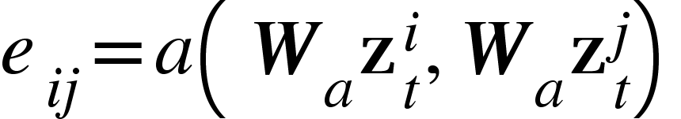
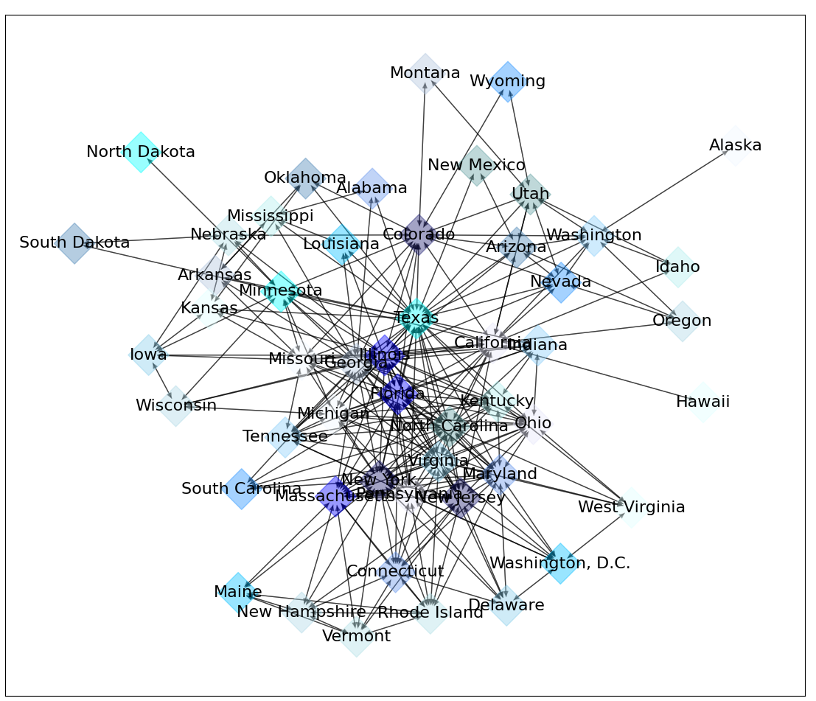
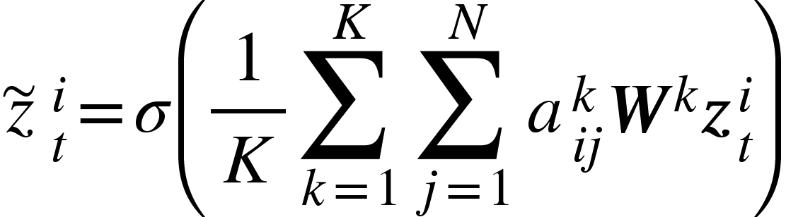
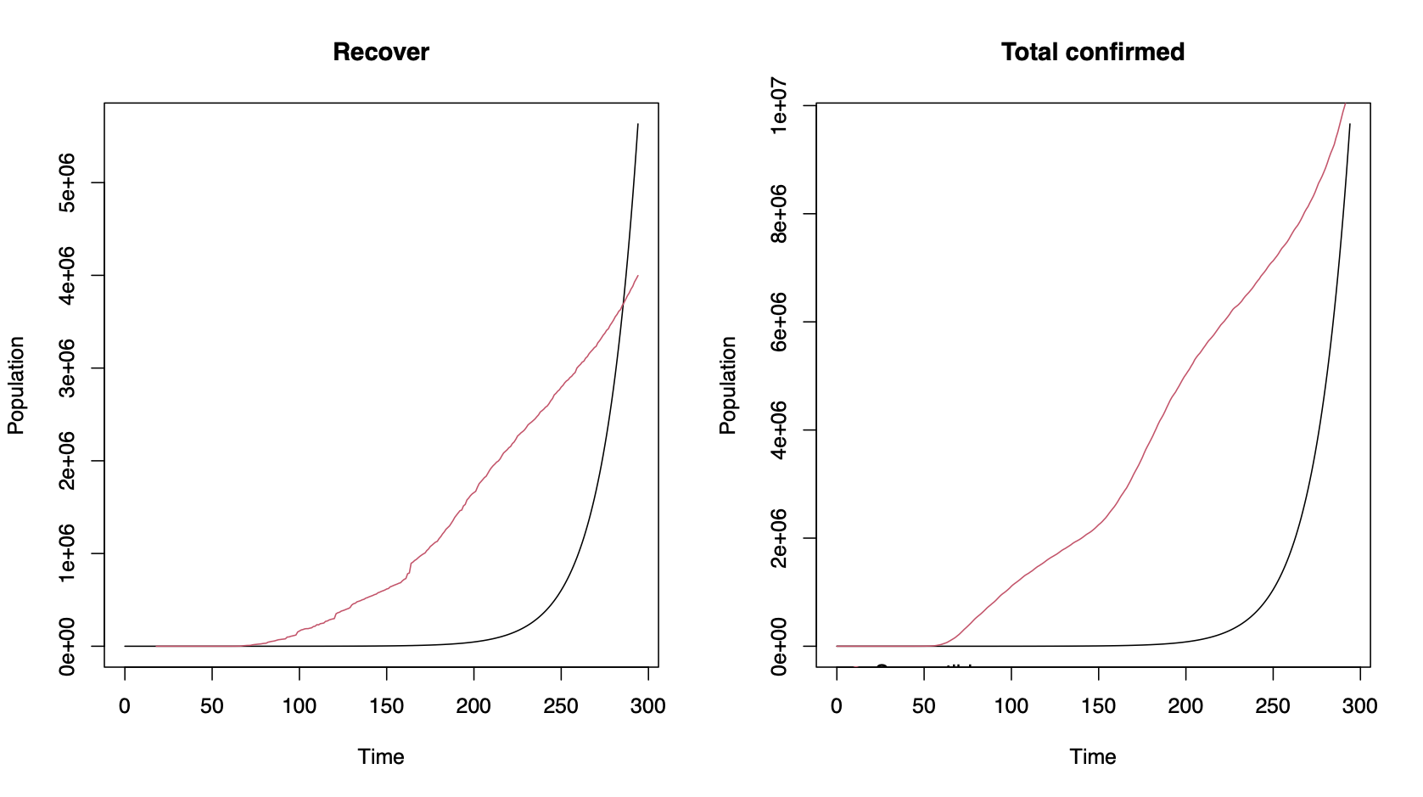
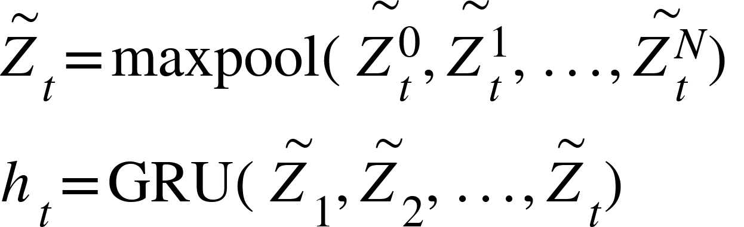
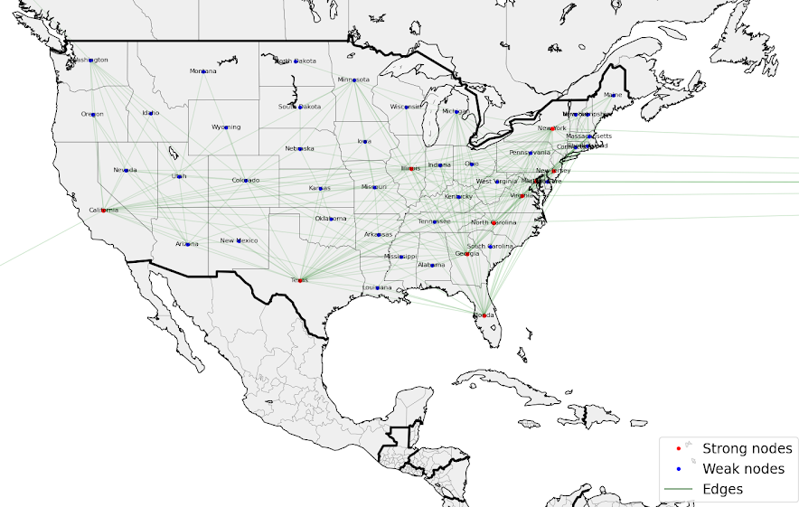
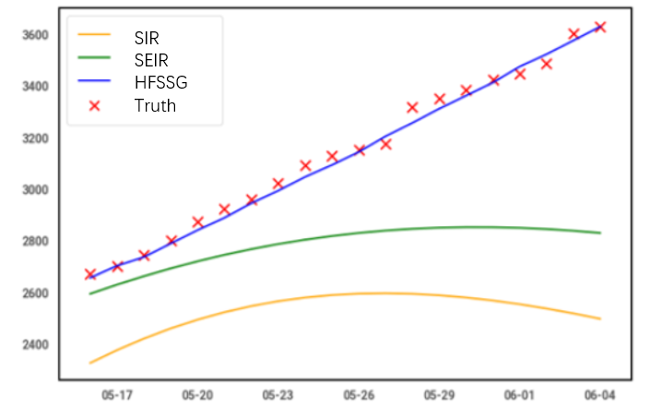
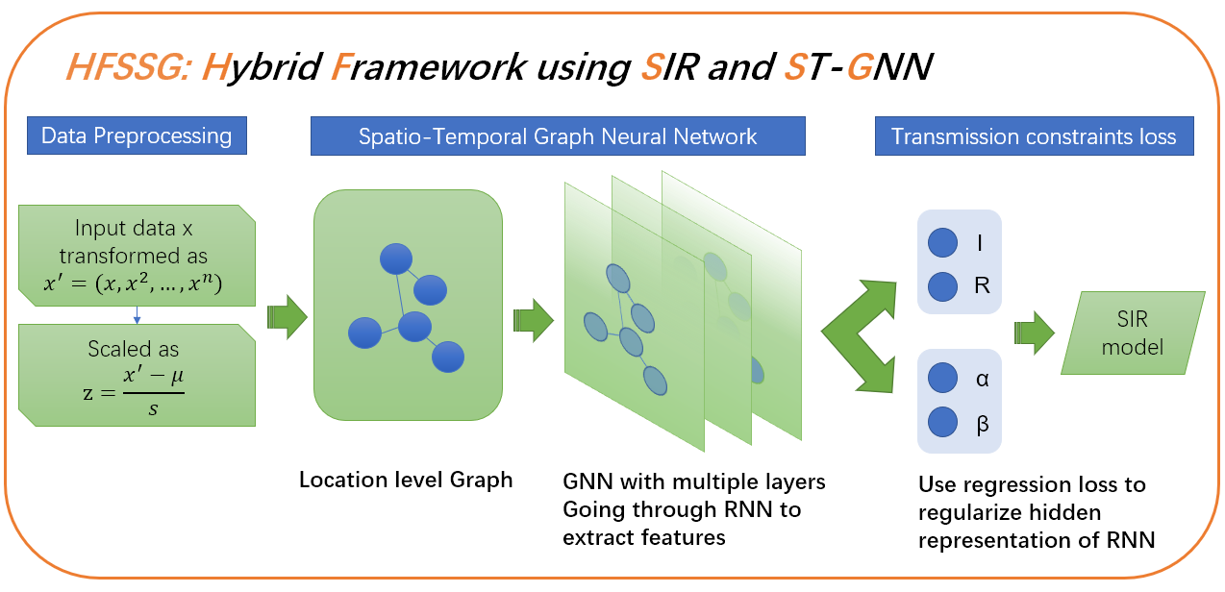
VE444 • Networks
Group# Course Project
HFSSG: A Hybrid Framework combining SIR pandemic model and Spatio-temporal Graph neural network forecasting the COVID-19 Impact in the United States
Team Members: Liqin Zhang, Zhejian Jin, Siyin Ma
Instructor: Prof. Yifei Zhu
Overview
In this work, we propose a novel hybrid framework aimed at COVID-19 case examination and feature prediction.
We mainly user SIR model for parameter learning and Graph Neural Network for temporal-spatial interaction study.
Motivation
Accurate real-time pandemic forecast is always a core technological problem against the implementation for policy makers and healthcaring system.
Fig 1. The Stable SIR model Fitting
However, existing forecasting models such as SIR(Fig.1) cannot address the information of the interaction dynamically, and it remains challenging considering the complex spatial and temporal dependencies among traffic flows.
Problem Statement
In this project, we combine two powerful models into one integrate framework to perform better prediction capabilities in COVID-19 cases with lower cost. We propose a novel hybrid multi-network based framework named HFSSG capturing geographical and temporal trends and predict the number of cases for a fixed number of days into the future.
Fig 2. The Flowchart of HFSSG framework
Algorithm Design
Use GCN to Extract Spatial Features
The Two Layer GCN:
Graph attention mechanism (GAT):
Node representation:
Use RNN to Extract Temporal Features
Node Embeddings:
GRU’s hidden representation:
Modeling and Analysis
We model the nodes in our graph as each state in the U.S., with features of strong and weak representing the travel availability compared among others. Training our custom GNN simply start with iterating the constructed training set and propagate the loss function.
Fig 3. The Spatio-Graph Neural Network Model
The hyper-parameters of our HFSSG model includes learning rate, epoch, and number of hidden units. In the experiment, learning rate and epoch were manually set on the basis of experiences as 0.01 and 2000 for both datasets. As for the number of hidden units, we set it to 50 for the nodes in each layer.
Results
Dataset description
NYT COVID-19 dataset: US state-level and county-level dataset includes active cases, confirmed cases and deaths since 21/01/2020
IQVIA’s claim data: 453,089 records of hospotal visits and medical code
Fig 4. Locate Aware Graph Embedding
Compared approaches
SIR: An epidemiological model separates people into susceptible, infected, and removed. Differential equation is used to simulate transmission.
SEIR: Similar to SIR, add exposed partition.
HFSSG: Best performance under various prediction time length in state-level and county-level
Evaluation strategy
Commine mean square error(MSE) and mean absolute error (MAE) together through agreement measurement.
Evaluation results
Fig 5. Predicted curve comparing 3 approaches
References
Alex Reinhart et al. 2018. A review of self-exciting spatio-temporal point processes and their applications. Statist. Sci. 33, 3 (2018), 299–318.
Zulong Diao, Xin Wang, Dafang Zhang, Yingru Liu, Kun Xie, and Shaoyao He. 2019. Dynamic spatial-temporal graph convolutional neural networks for traffic forecasting. In Proceedings of the AAAI Conference on Artificial Intelligence, Vol. 33. 890–897.

Slide 2
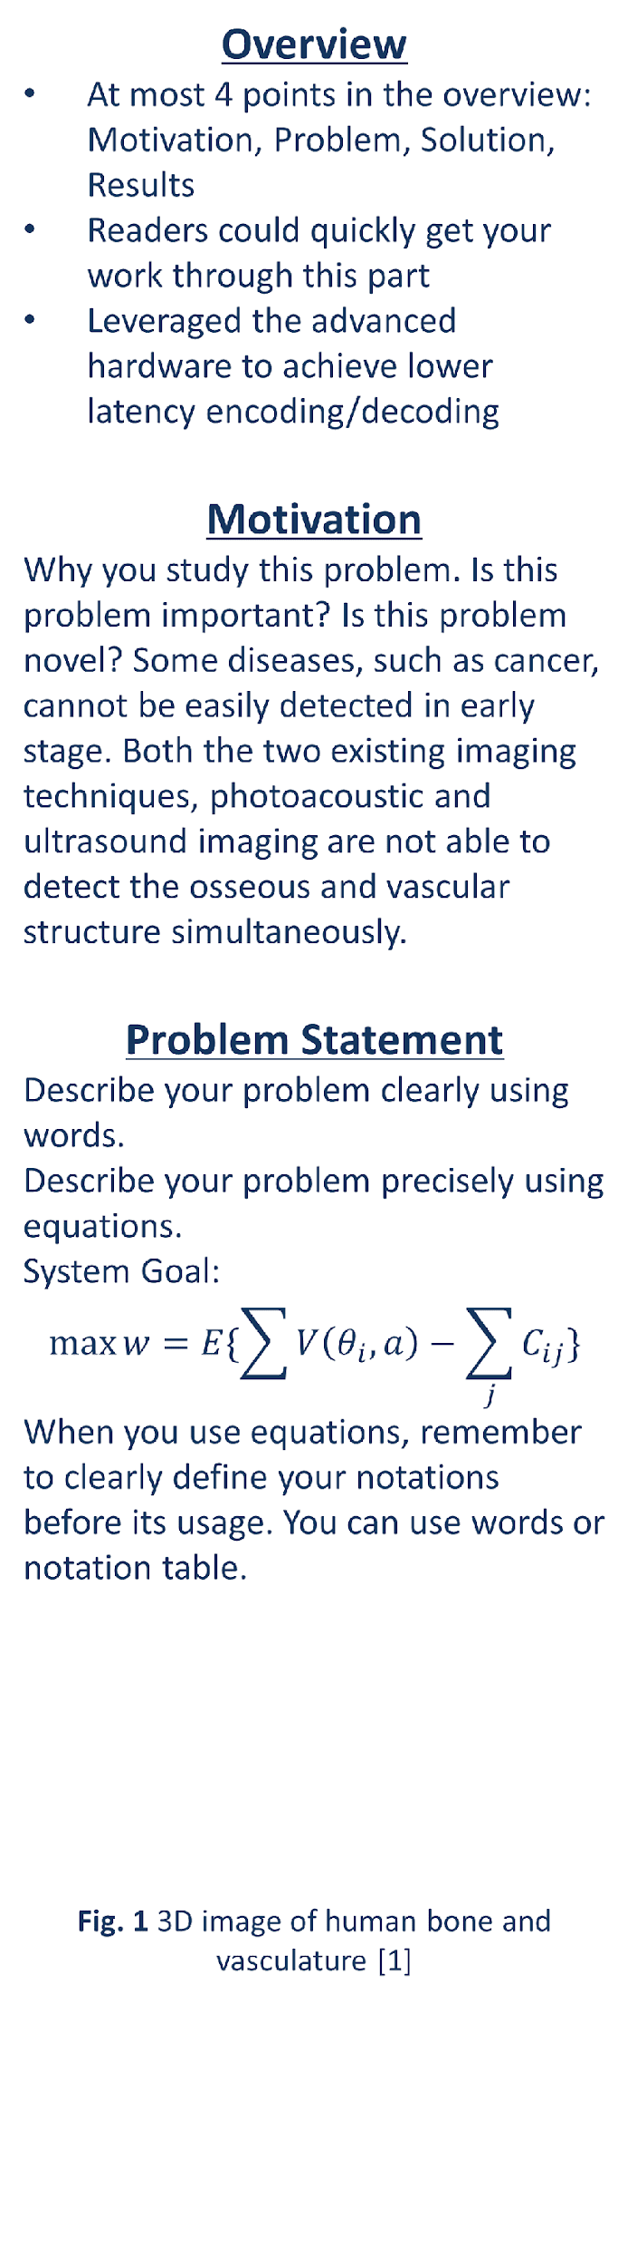
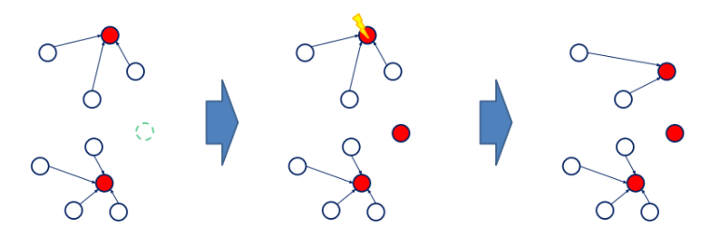
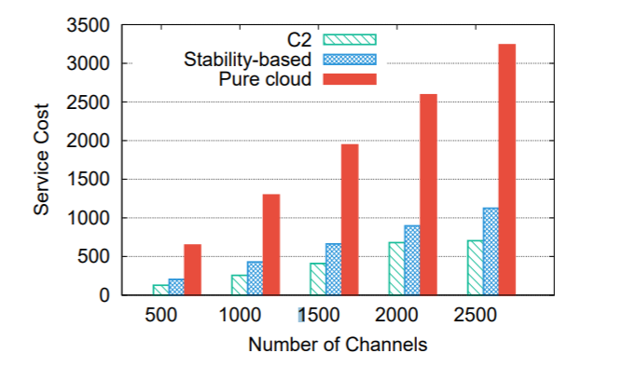
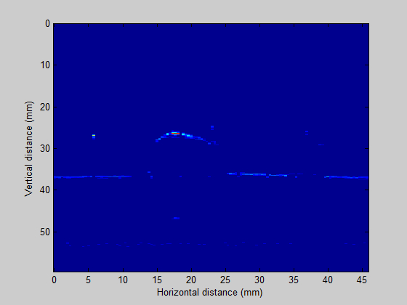
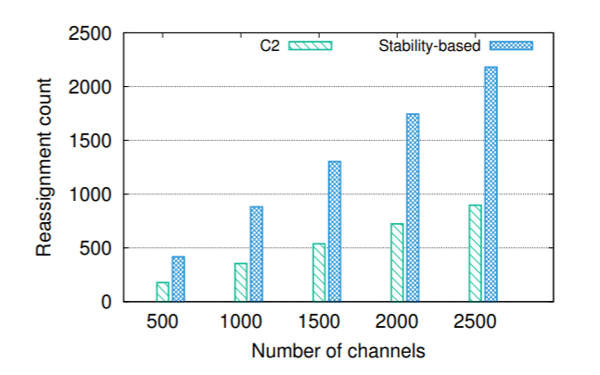
VE444 • Networks
Group# Course Project
这页是Template!!
Algorithm Design
This part serves to describe your algorithm in details. Please remember to use tables, algorithms, figures, equations, toy examples instead of simply word descriptions to summarize your design.
Algorithm sketch:
Compute ,,,
Iterating until
,,,
…
Compute
Fig.4 Example for my algorithm
Modeling and Analysis
If you are doing a modelling work, you can focus more on modelling part, what your model looks like. Analysis of your model.
Fig. 5 2D bone profile
Note that usually we need to fill up the whole poster.
Results
Dataset description:
Use words or tables to summarize the basic statistics of your dataset. Source. Size. Diameter. Average degree, etc.
You can also visualize your network using graphs.
Compared approaches:
Approach 1: Briefly describe this approach
Approach 2:Briefly describe this approach
Evaluation results:
Reassignment counts
Service cost comparison
Summarize your presented results in words here.
Any interesting findings 1
Any interesting finding 2
References
At most 3 references
Reference1
Reference2
Source
Node size
Edge size

Slide 3
